Slide 1
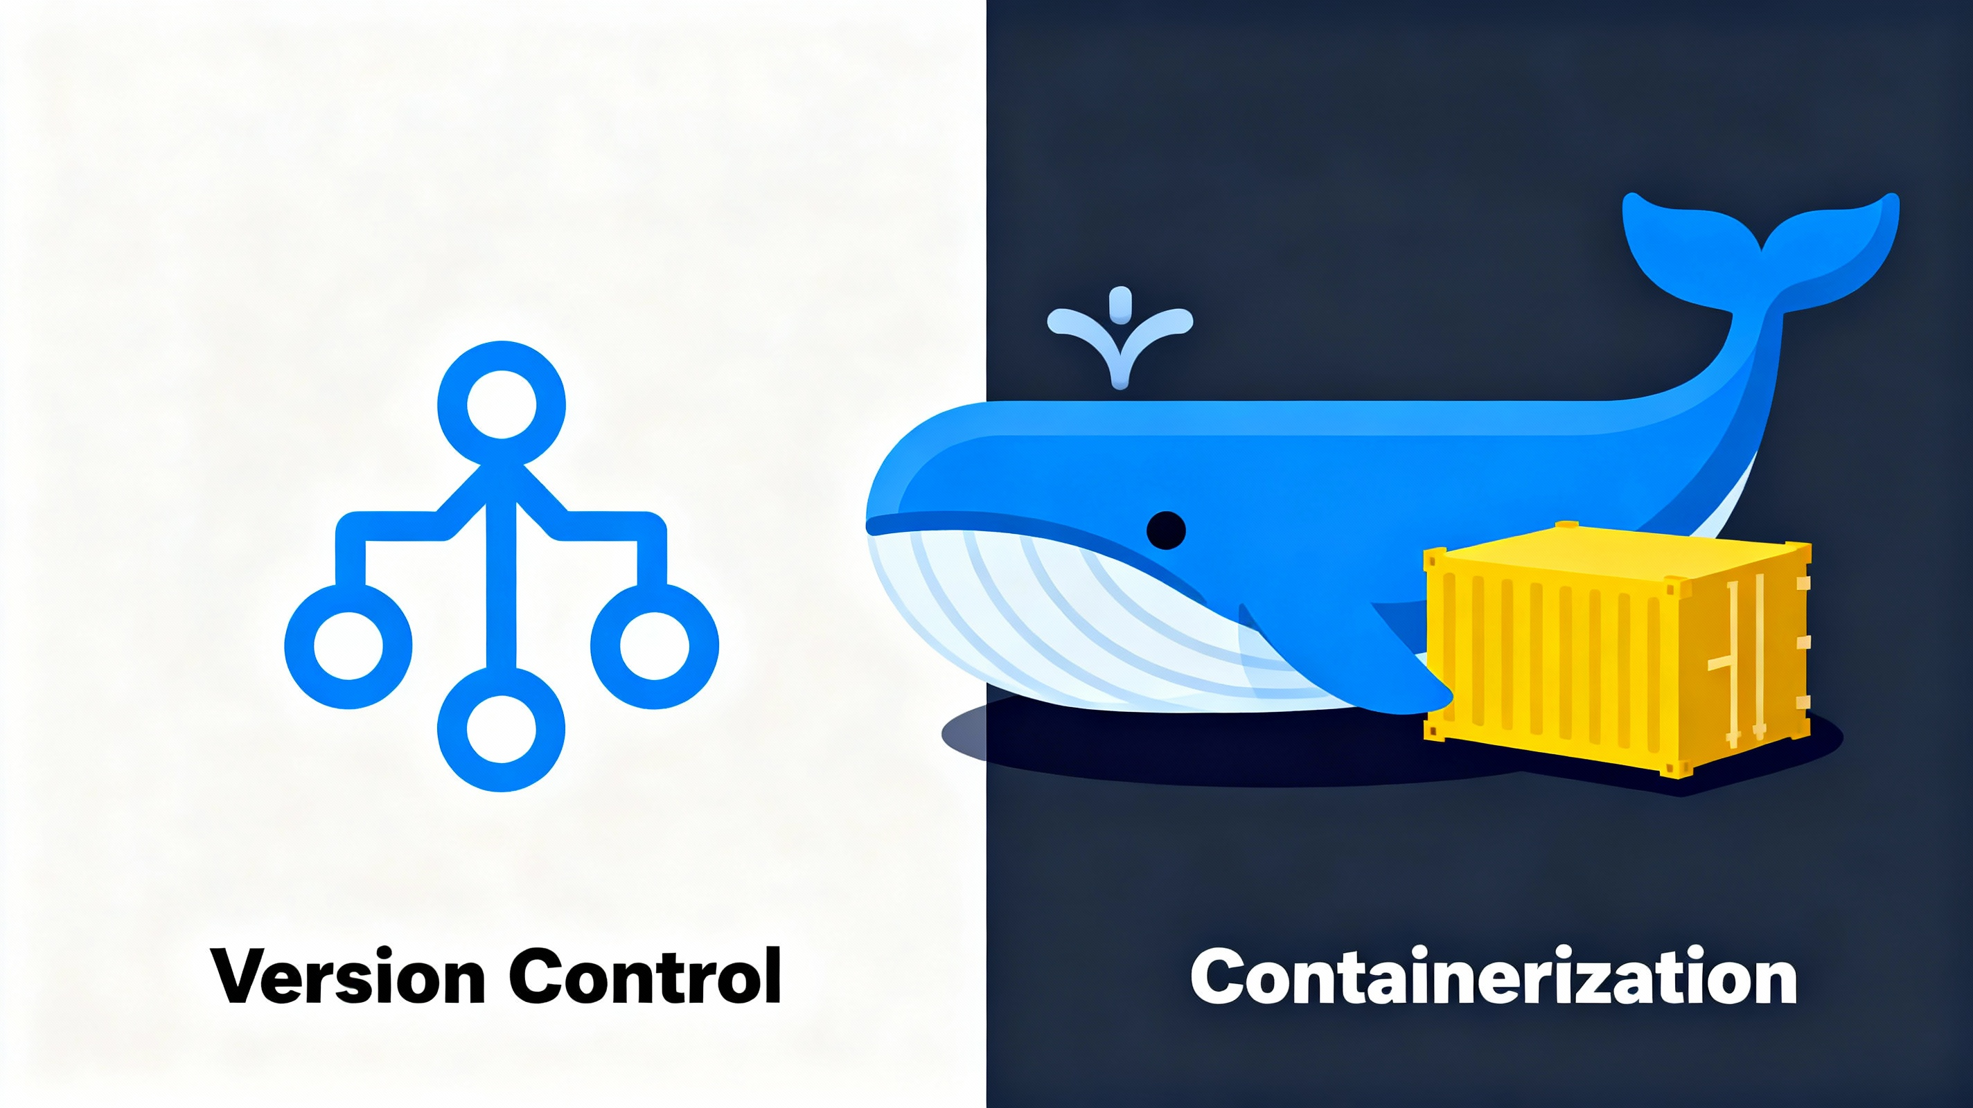
Workshop-Day1
Version Control and Containerization
13 NOV 2025 | Icfai Tech
SJ
by Santhosh Kiran Jaligama

Slide 2
Agenda
Morning Sessions:
Session 1 (10:00-11:30) - GitHub as the DevOps Hub
Session 2 (11:40-13:00) - Docker & Containerization
Afternoon Session:
Hands-On Project: Calculator Microservices
Build, containerize, and push to Docker Hub
Outcome: Working microservices deployed to Docker Hub

Slide 3
DevOps is a mindset that emphasizes collaboration and continuous improvement between development and operations teams. It's also a set of technical practices and cultural philosophies that help organizations deliver applications and services faster.
- The DevOps Handbook

Slide 4
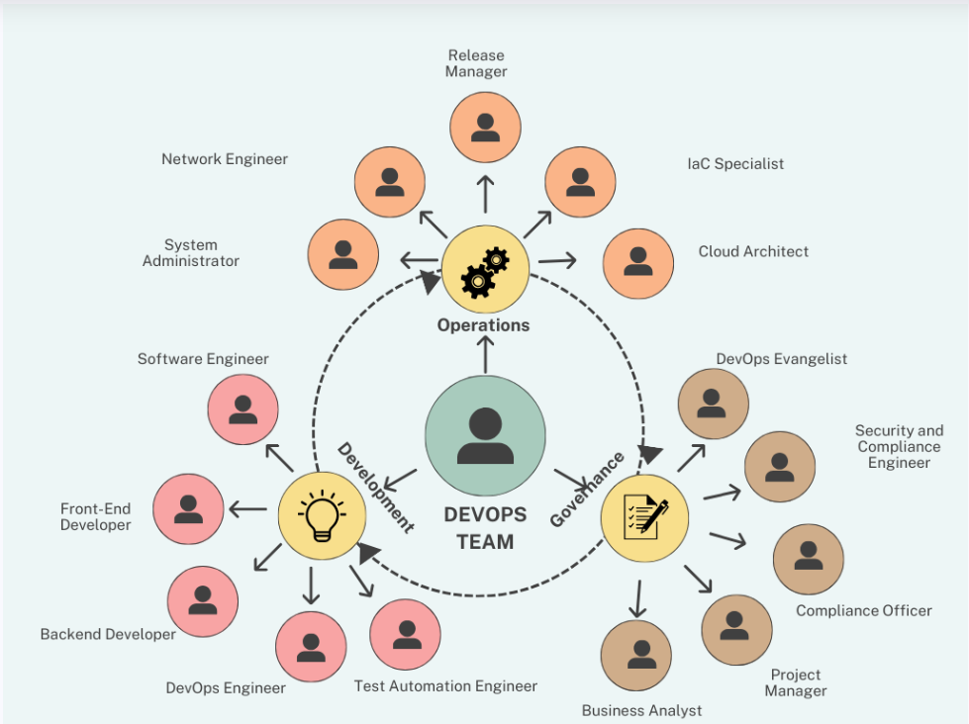
DevOps Roles in Industry

Slide 5
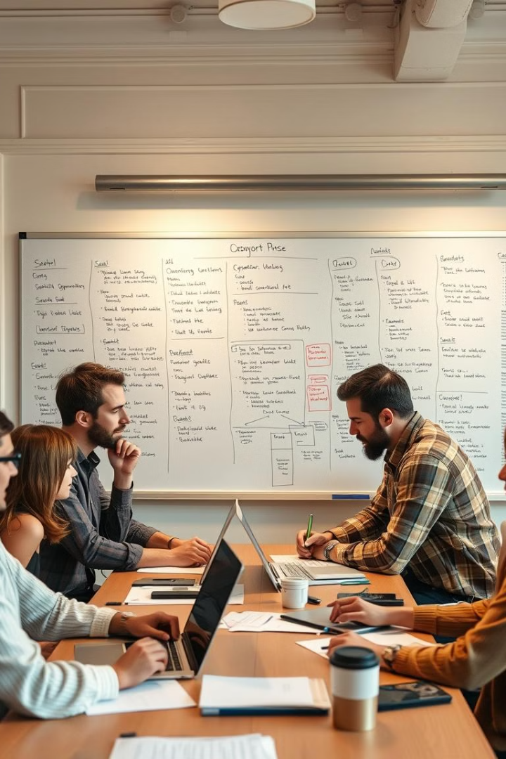
The DevOps Mindset: Bridging Development and Operations
Collaboration
Automation
DevOps promotes a culture of collaboration between development and operations teams, breaking down traditional silos and fostering shared responsibility for the entire software lifecycle.
Automation is at the heart of DevOps, automating repetitive tasks and workflows, freeing up developers and operations engineers to focus on higher-value activities.
Continuous Improvement
DevOps encourages continuous improvement, emphasizing data-driven insights, feedback loops, and iterative refinement, leading to faster and more reliable software delivery.
Code
Version Control
Build
→
Test
Deploy
Monitor
Feedback
(Dev) (Git/GitHub) (CI) (CI) (CD) (Ops) (Loop)

Slide 6
What is DevOps?
The Bridge Between Development & Operations
Code
→
Version Control
→
Build
→
Test
→
Deploy
→
Monitor
→
Feedback
(Dev) (Git/GitHub) (CI) (CI) (CD) (Ops) (Loop)
Key Pillars:
Continuous Integration (CI) - Automated testing
Continuous Delivery/Deployment (CD) - Automated deployment
Infrastructure as Code (IaC) - Automation scripts
Monitoring & Observability - Real-time insights

Slide 7
Key Concepts in Software Development and Operations (DevOps Methodology)
1
2
3
CI/CD
Infrastructure as Code (IaC) & GitOps
MLOps
Automates the entire software build, test, and deployment process. It ensures code changes are integrated and released rapidly and reliably.
This practice manages and provisions infrastructure through code, ensuring consistency, reducing manual errors, and speeding up deployment.
Applies DevOps principles to machine learning to automate the entire model lifecycle. It streamlines the deployment, monitoring, and management of ML models in production.
5
6
4
DevSecOps
Cloud and Infrastructure Management
Monitoring & Observability
Integrates security practices directly into the development lifecycle from the start. This proactive approach helps identify and fix vulnerabilities early and continuously.
The overall strategy for operating and maintaining cloud-based infrastructure. It relies heavily on automation to ensure environments are consistent, scalable, and cost-effective.
Tools and practices to understand the health and performance of systems. It involves tracking metrics and using logs to gain deep insights into why a system is behaving a certain way.

Slide 8
Key Concepts in Software Development and Operations (DevOps Methodology)
7
8
9
Platform Engineering
Mobile CI/CD
Site Reliability Engineering (SRE)
Builds and maintains internal platforms with tools and services for developers. This reduces a developer's cognitive load and boosts their productivity by providing a seamless workflow.
A specialized CI/CD practice for mobile app development. It automates the complete process from code commits to distributing the app to app stores.
Applies software engineering principles to operations to build and run highly reliable systems. It focuses on automation, incident response, and meeting service level objectives (SLOs).

Slide 9
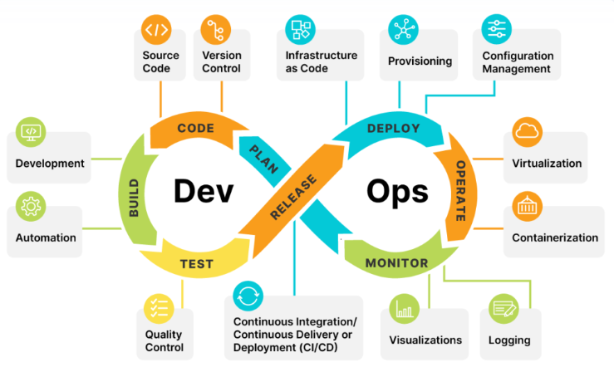
DevOps in Nutshell

Slide 10
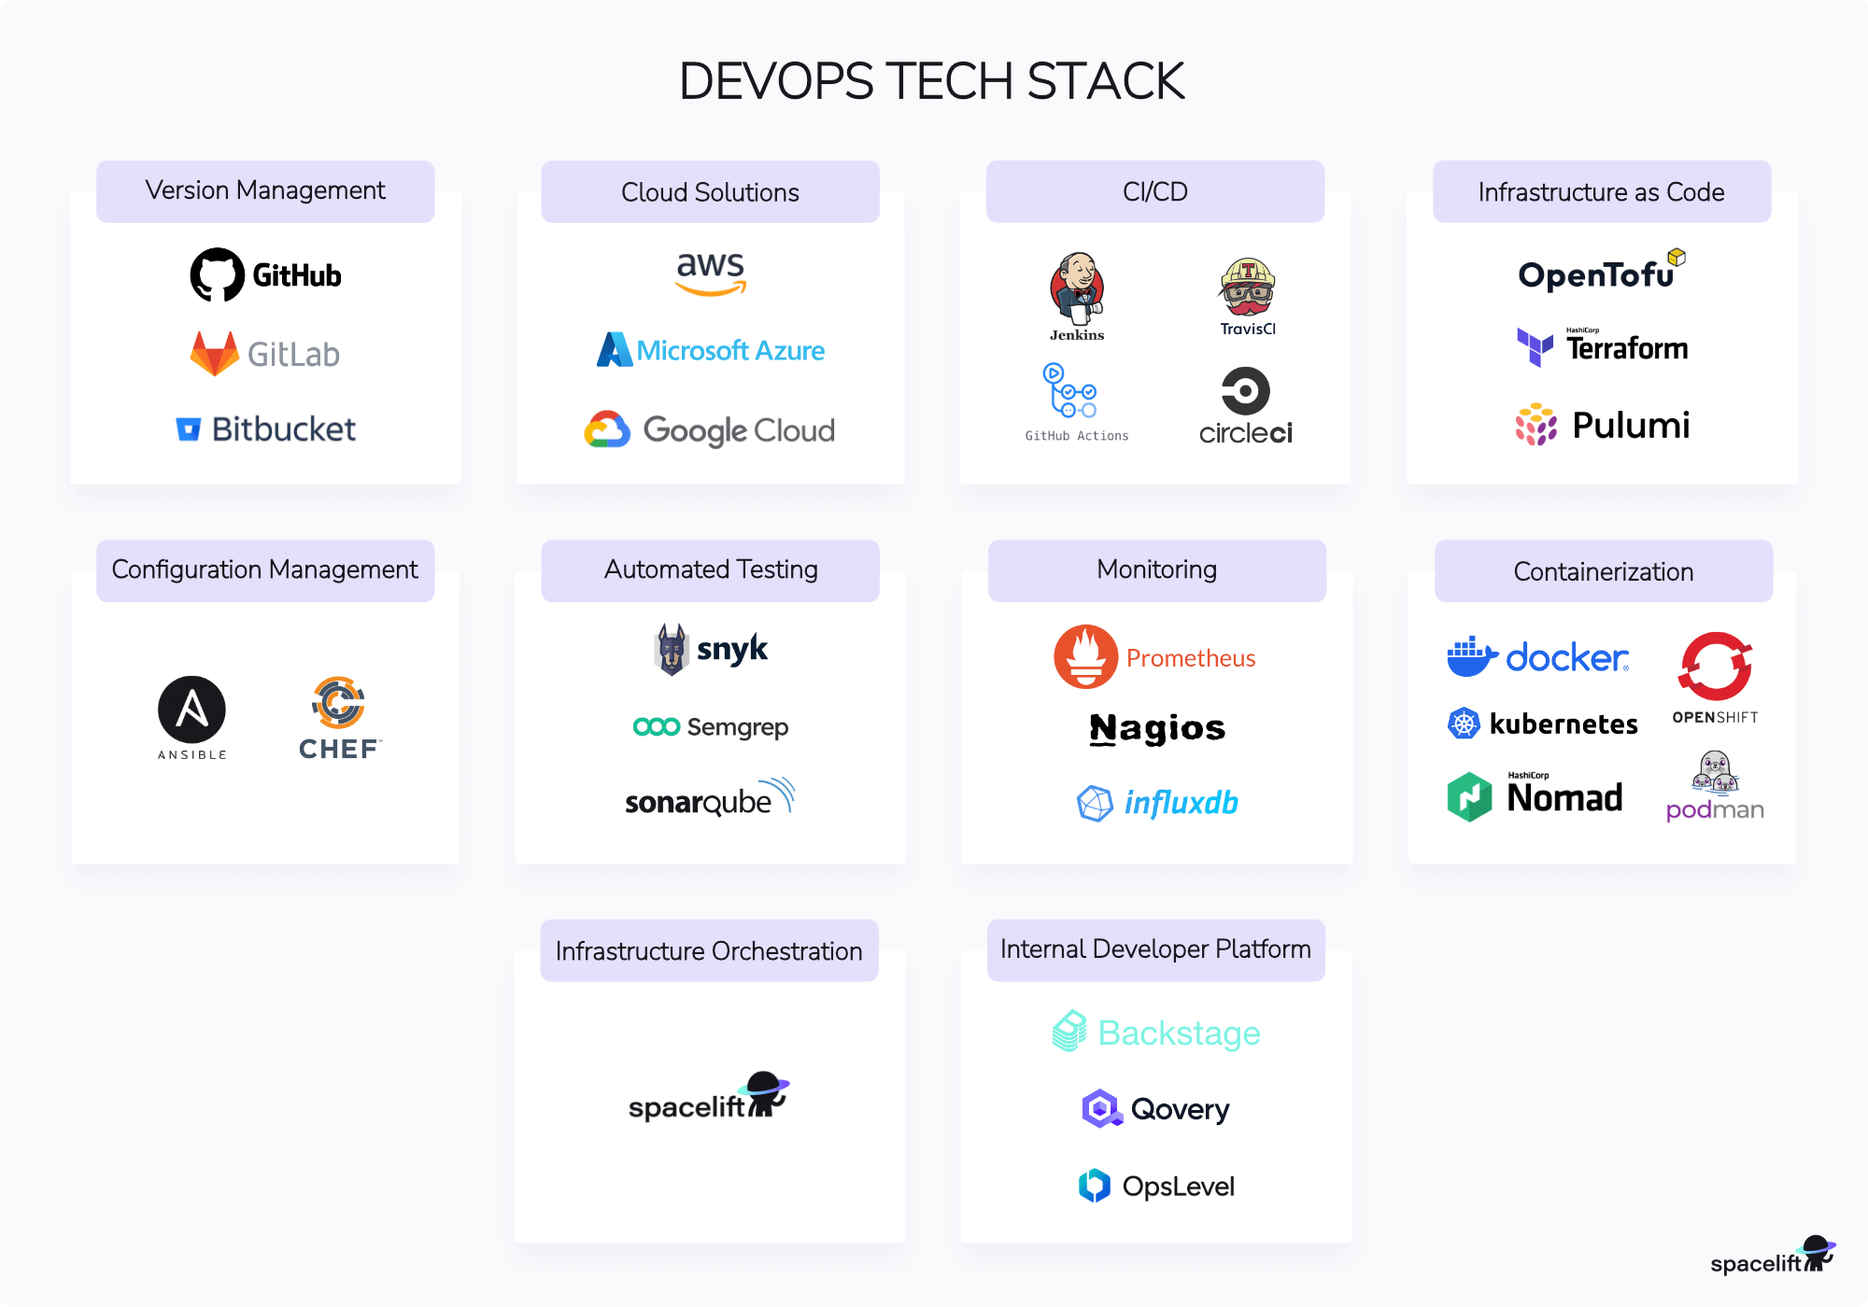

Slide 11
Core Pillar 1: Infrastructure as Code (IaC)
Defining Infrastructure with Code
A Look at the Tools
Definition: The practice of managing and provisioning IT infrastructure using machine-readable definition files.
Benefit: Enables consistent and repeatable environment creation. No more "snowflake" servers.
How it Works: You write a script that describes the infrastructure you need (e.g., 50 GPUs, 20 CPUs, specific RAM). The IaC tool provisions it for you.
Terraform: Vendor-agnostic tool to provision infrastructure across multiple cloud providers.
Ansible: Automation engine for configuration management and application deployment.
CloudFormation (AWS): A service for modeling and setting up your AWS resources.

Slide 12
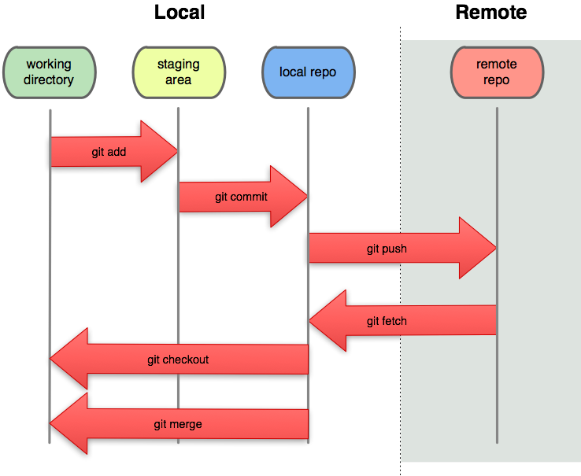
Git Commands

Slide 13
GitHub: More Than a Code Repository
Feature
Purpose
Repositories
Centralized code storage with version history
Branches
Parallel development without conflicts
Issues
Track features, bugs, and tasks
Pull Requests
Code review and merging workflow
Project Boards
Kanban-style task management
Webhooks
Automated triggers for CI/CD
Actions
Built-in CI/CD automation
Key Takeaway: GitHub is a complete DevOps hub—managing planning, development, testing, and deployment.

Slide 14
GitHub Flow: Branching Strategy
Visual Workflow:
Main Branch (Production)
←
Always production-ready
↑
├─
feature/add-division (Feature Branch)
│
├─
Commit 1: Add division logic
│
├─
Commit 2: Add tests
│
└─
Pull Request (Code Review)
│
├─
CI Tests Pass
✓
│
├─
Reviewer Approves
✓
│
└─
Merge to Main
→
Deploy
5-Step Process:
1. Create branch:
git checkout -b feature/feature-name
2. Commit changes:
git commit -m "Clear message"
3. Push:
git push origin feature/feature-name
4. Open Pull Request on GitHub
5. Code review → Merge → Deploy

Slide 15
Issues & Project Boards
Issues - Task Tracking:
Create for features: "Add multiplication microservice"
Track bugs: "Fix division by zero error"
Organize with labels:
bug
,
feature
,
documentation
Project Boards - Team Coordination:
Kanban workflow: To Do → In Progress → In Review → Done
Automated: Linked issues move automatically
Visibility: Entire team sees progress
Example - Calculator Project Board:
To Do
In Progress
In Review
Done
Add Service Setup
Add Division MS
Addition PR #12
Subtraction MS
Add Multiplication
Documentation

Slide 16
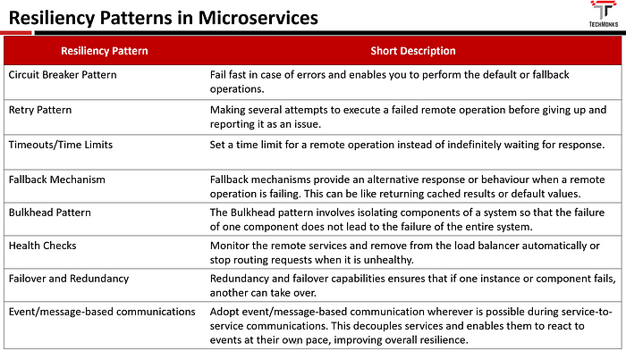
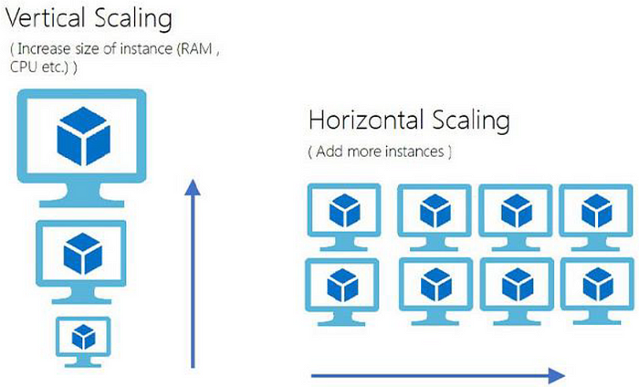
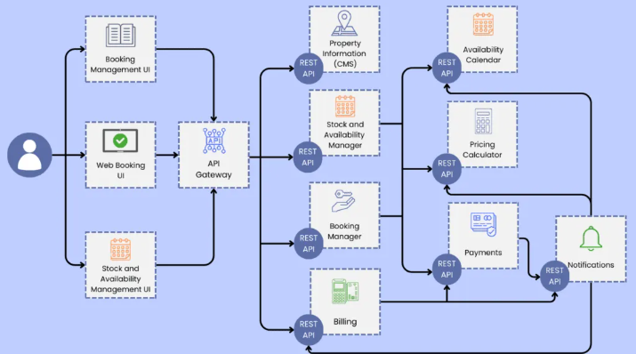
Microservices Architecture: Scalability and Resilience
Modularity
Scalability
Microservices break down complex applications into smaller, independent services, making them easier to develop, maintain, and scale, reducing the overall complexity of the system.
Individual microservices can be scaled independently, allowing teams to allocate resources efficiently, ensuring that only the necessary components are scaled to meet demand, maximizing resource utilization.
Resilience
Failures in one microservice are contained, preventing cascading failures across the entire application, ensuring continuous availability and minimizing service disruptions.

Slide 17
Monolith vs. Microservices
Aspect
Monolithic
Microservices
Structure
Single app (all logic together)
Individual services (Add, Subtract, Multiply, Divide)
Deployment
Deploy entire app for one bug fix
Deploy only the affected service
Scaling
Scale everything (wasteful)
Scale only busy services (efficient)
Technology
One stack for all
Mix frameworks per service
Failure
One bug crashes everything
One service fails, others run
Development
All devs conflict on same code
Teams own individual services

Slide 18
Session 2
Docker & Containerization

Slide 19
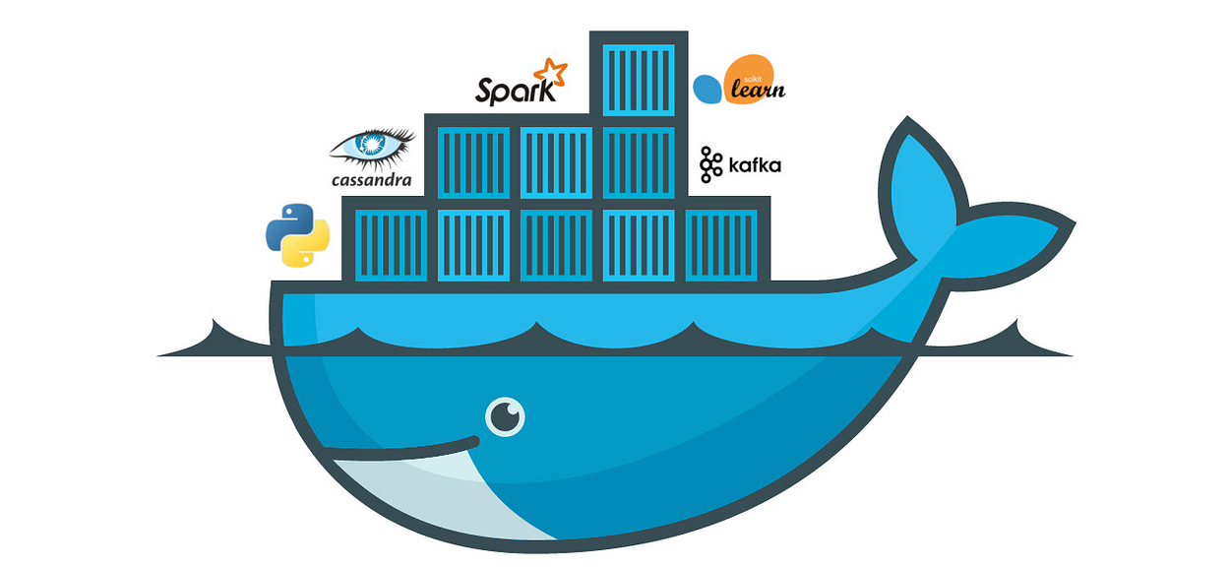
Core Pillar 2: Containerization
Packaging for Consistency
Definition: Bundling an application and all its dependencies into a single, isolated package called a container.
Tools: Docker is the de facto standard.
Why it's crucial for ML: An ML model often depends on specific versions of libraries (e.g., TensorFlow 2.8, PyTorch 1.12), CUDA drivers, etc. A container ensures all these dependencies are always correct.

Slide 20
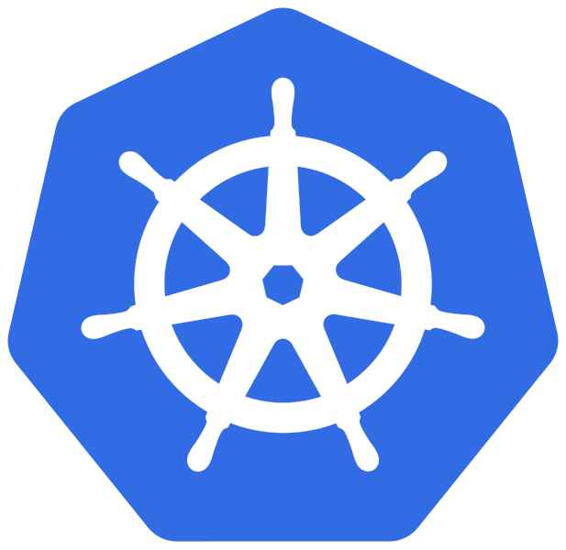
Core Pillar 3: Orchestration
Managing the Swarm of Containers
Definition: Automating the deployment, scaling, and management of containerized applications.
Tool: Kubernetes (K8s) is the leading container orchestrator.
Why it's crucial for supercomputing: Kubernetes can schedule your ML training jobs across a cluster of thousands of GPUs, automatically restarting failed jobs and ensuring resource efficiency.

Slide 21
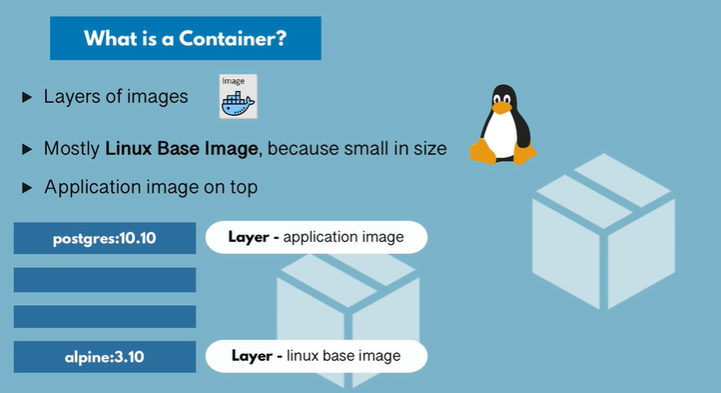

Slide 22
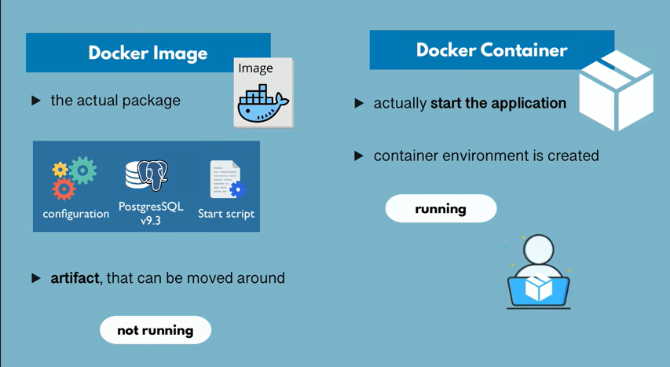

Slide 23
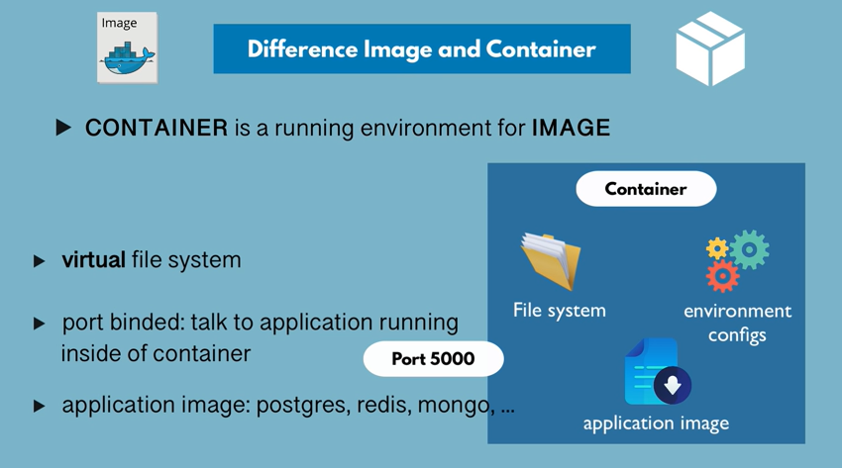

Slide 24
Containerization Tools
Docker: Open-source platform for developing, shipping, and running applications.
Kubernetes: Container orchestration tool for managing containerized applications.
AWS Fargate: Serverless compute engine for running containers.
Azure Container Instances: Managed container instances for running containers without managing the infrastructure.

Slide 25
Docker: The "Works on My Machine" Problem
The Problem:
Developer's Laptop: Production Server:
- Python 3.10 - Python 3.8 (Different!)
- Node.js 18 - Node.js 16
- PostgreSQL 14 - PostgreSQL 12
✓
App works fine
✗
App crashes!
The Docker Solution:
Docker ensures consistency across all environments—dev, test, staging, production.
Docker Image = Environment Blueprint
├─
Base OS (Alpine Linux)
├─
Runtime (Node.js 18)
├─
Dependencies (npm packages)
├─
Application Code
└─
Configuration
Once tested in a Docker container, it runs identically everywhere.
8

Slide 26
Dockerfile: Building Images
Example Dockerfile for Node.js Service:
FROM node:18-alpine
WORKDIR /app
COPY package.json .
RUN npm install
COPY . .
EXPOSE 3000
CMD ["node", "server.js"]
Breakdown:
FROM node:18-alpine
- Base image (small, fast)
WORKDIR /app
- Set working directory
COPY package.json .
- Copy dependencies file
RUN npm install
- Install dependencies
COPY . .
- Copy application code
EXPOSE 3000
- Document exposed port
CMD ["node", "server.js"]
- Run command

Slide 27
Dockerfile: Building Images
Best Practices:
Use official base images (node, python, java)
Use smaller base images (alpine, slim)
Layer dependencies and code separately
Add `.dockerignore` (like `.gitignore` for Docker)

Slide 28
Session 2
Docker & Containerization

Slide 29
Our Project: Calculator Microservices
Architecture:
┌─────────────────────────────────────┐
│
API Gateway (Router)
│
├─────────────────────────────────────┤
│
│
│
│
│
│
↓
↓
↓
↓
│
Add Sub Multiply Divide
│
MS MS MS MS
└─────────────────────────────────────┘
↓
Docker Hub Registry
↓
Kubernetes Cluster (Tomorrow!)
calculator-microservices/
├──
gateway/
├──
add-service/
├
b
i
/

Slide 30
Hands-On: Project Setup
Step 1: Create GitHub Repository
# Go to github.com
→
New Repository
# Name: calculator-microservices
# Description: DevOps workshop project
# Public (for Docker Hub later)
# Initialize with README
Step 2: Clone Locally
git clone –b BRANCHNAME https://github.com/YOUR-USERNAME/calculator-microservices.git
cd calculator-microservices
Step 3: Create Project Structure (PowerShell)
$services = @("gateway", "add-service", "subtract-service", "multiply-service", "divide-service")
foreach ($s in $services) {
mkdir $s
echo "console.log('[$s] started')" > $s/server.js
echo "FROM node:18-alpine" > $s/Dockerfile
12
}

Slide 31
Command Reference
Git Commands:
git clone <repo>
# Clone repository
git checkout -b feature/name
# Create feature branch
git add .
# Stage changes
git commit -m "message"
# Commit with message
git push origin branch
# Push to remote
git pull origin main
# Get latest main
git log --oneline
# View history
Docker Commands:
docker build -t name:tag .
# Build image
docker run -p host:container img
# Run container
docker ps
# List containers
docker stop <id>
# Stop container
docker login
# Login to Docker Hub
docker push user/img:tag
# Push to registry
14

Slide 32
Day 1 Summary
What You Accomplished:
1.
Mastered GitHub Flow for collaboration
2.
Understood microservices architecture
3.
Learned Docker containerization concepts
4.
Created project structure on GitHub
5.
Built foundation for CI/CD
Key Takeaways:
GitHub = Version control & DevOps hub
Microservices = Independent, scalable services
Docker = Consistent, portable environments
Workflow = Branch → Code → Test → Merge → Deploy
Tomorrow's Preview:
Morning: Jenkins CI/CD Pipelines
Afternoon: Kubernetes Orchestration & End-to-End Automation
Questions?

Slide 33

Q&A
Engage and Explore!

